Slide 1
Container Orchestration with Kubernetes (K8s)
Application Frameworks (SE3040)
Vishan Jayasinghearachchi Lecturer
Department of Software Engineering, Faculty of Computing
vishan.j@sliit.lk

Slide 2
Contents
Kubernetes Overview
What is Kubernetes (K8s)?
What can K8s do?
K8s Components
The Control Plane
Nodes
How does everything wire together?
Lesson Recap
Self-study

Slide 3
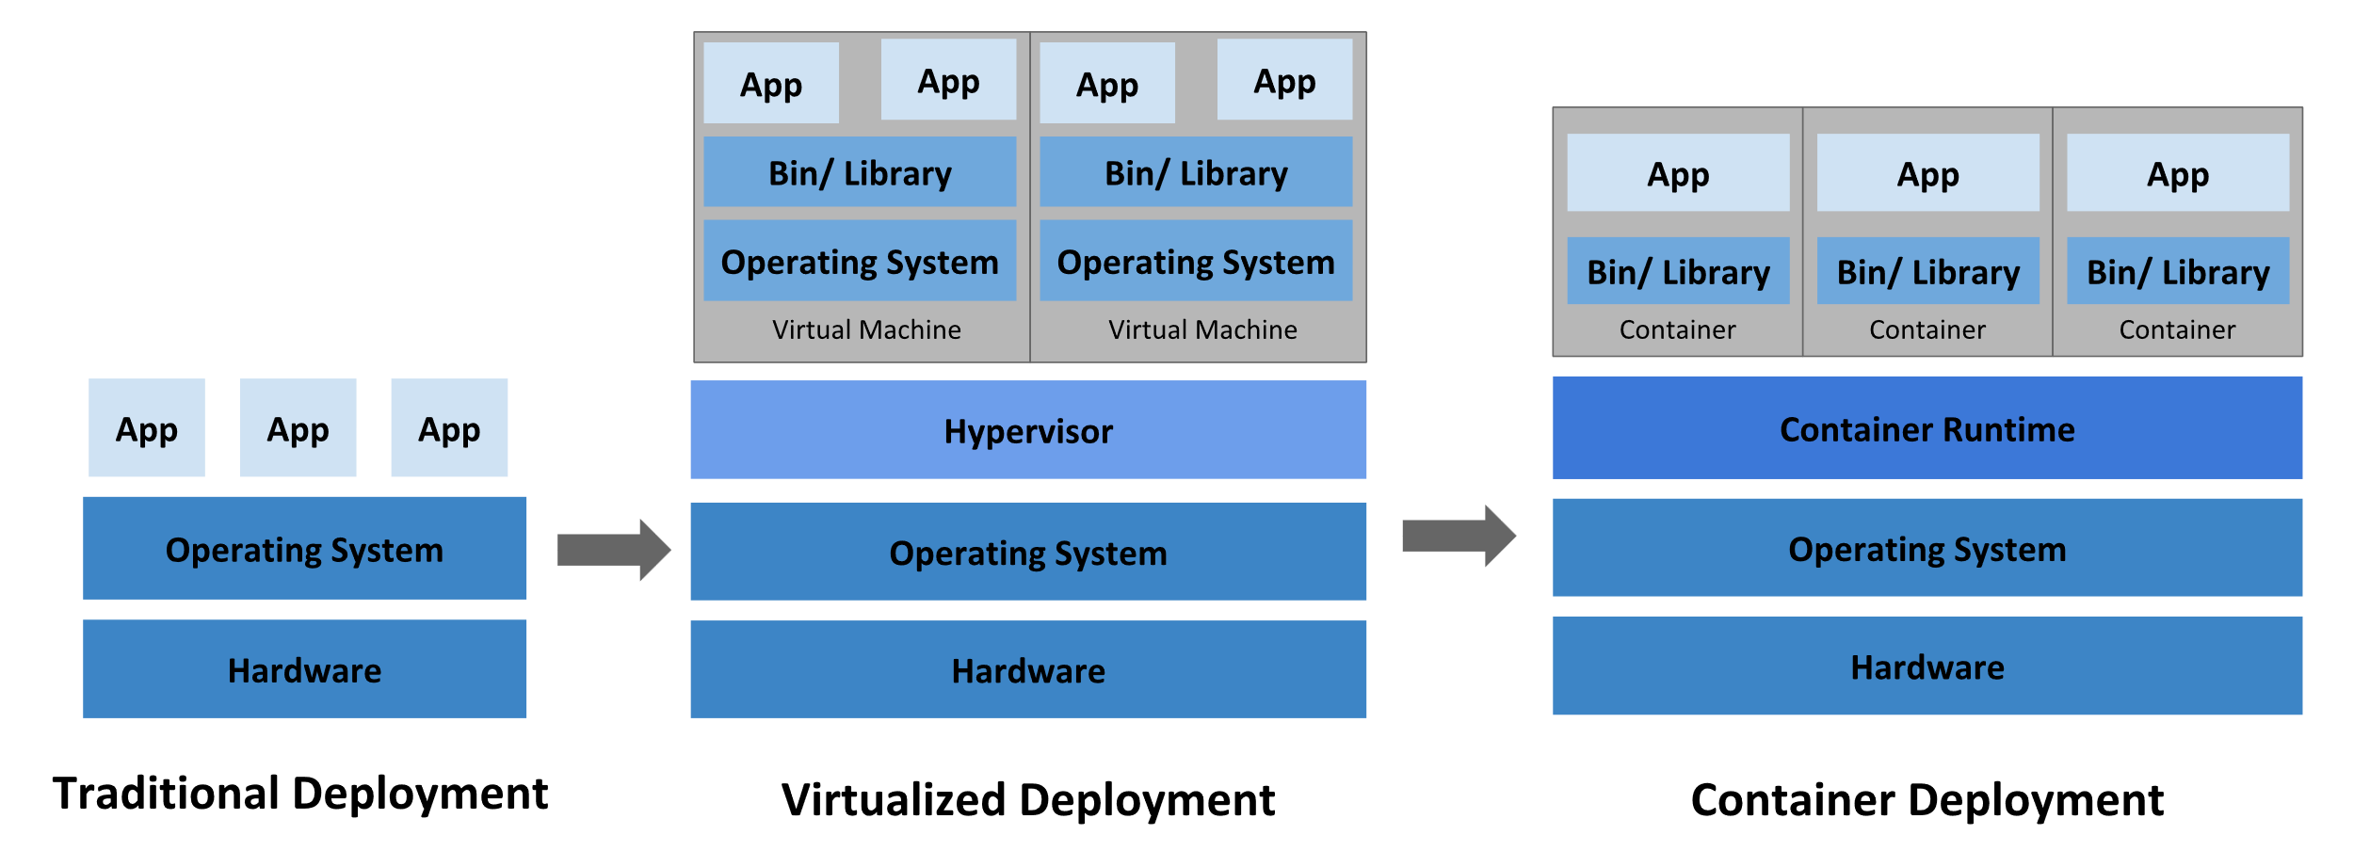
Evolution of Deployment Methodologies
3

Slide 4
Container Orchestration
Why is it needed?
In small numbers, one can manually deploy and manage containers.
But what would happen in an enterprise scenario, where millions of customers are constantly requesting for different types of services? Eg: Google search?
It is impossible to handle this load manually. Automation is needed.
Container Orchestration is the solution.

Slide 5
Container Orchestration
How does it work?
Usually, a developer writes a configuration file which is understood by the Orchestration tool.
This configuration file defines the desired state the containerized application (i.e. the containers which make it up) should be in.
The orchestration tool, based on this configuration file, maintains the state of the containers (actual state) to resemble the desired state.
It manages the deployment of the containers, resiliency, selection of the host (to deploy the containers).
Once deployed, it manages scalability, availability and performance and even collecting and logging data for later review.

Slide 6
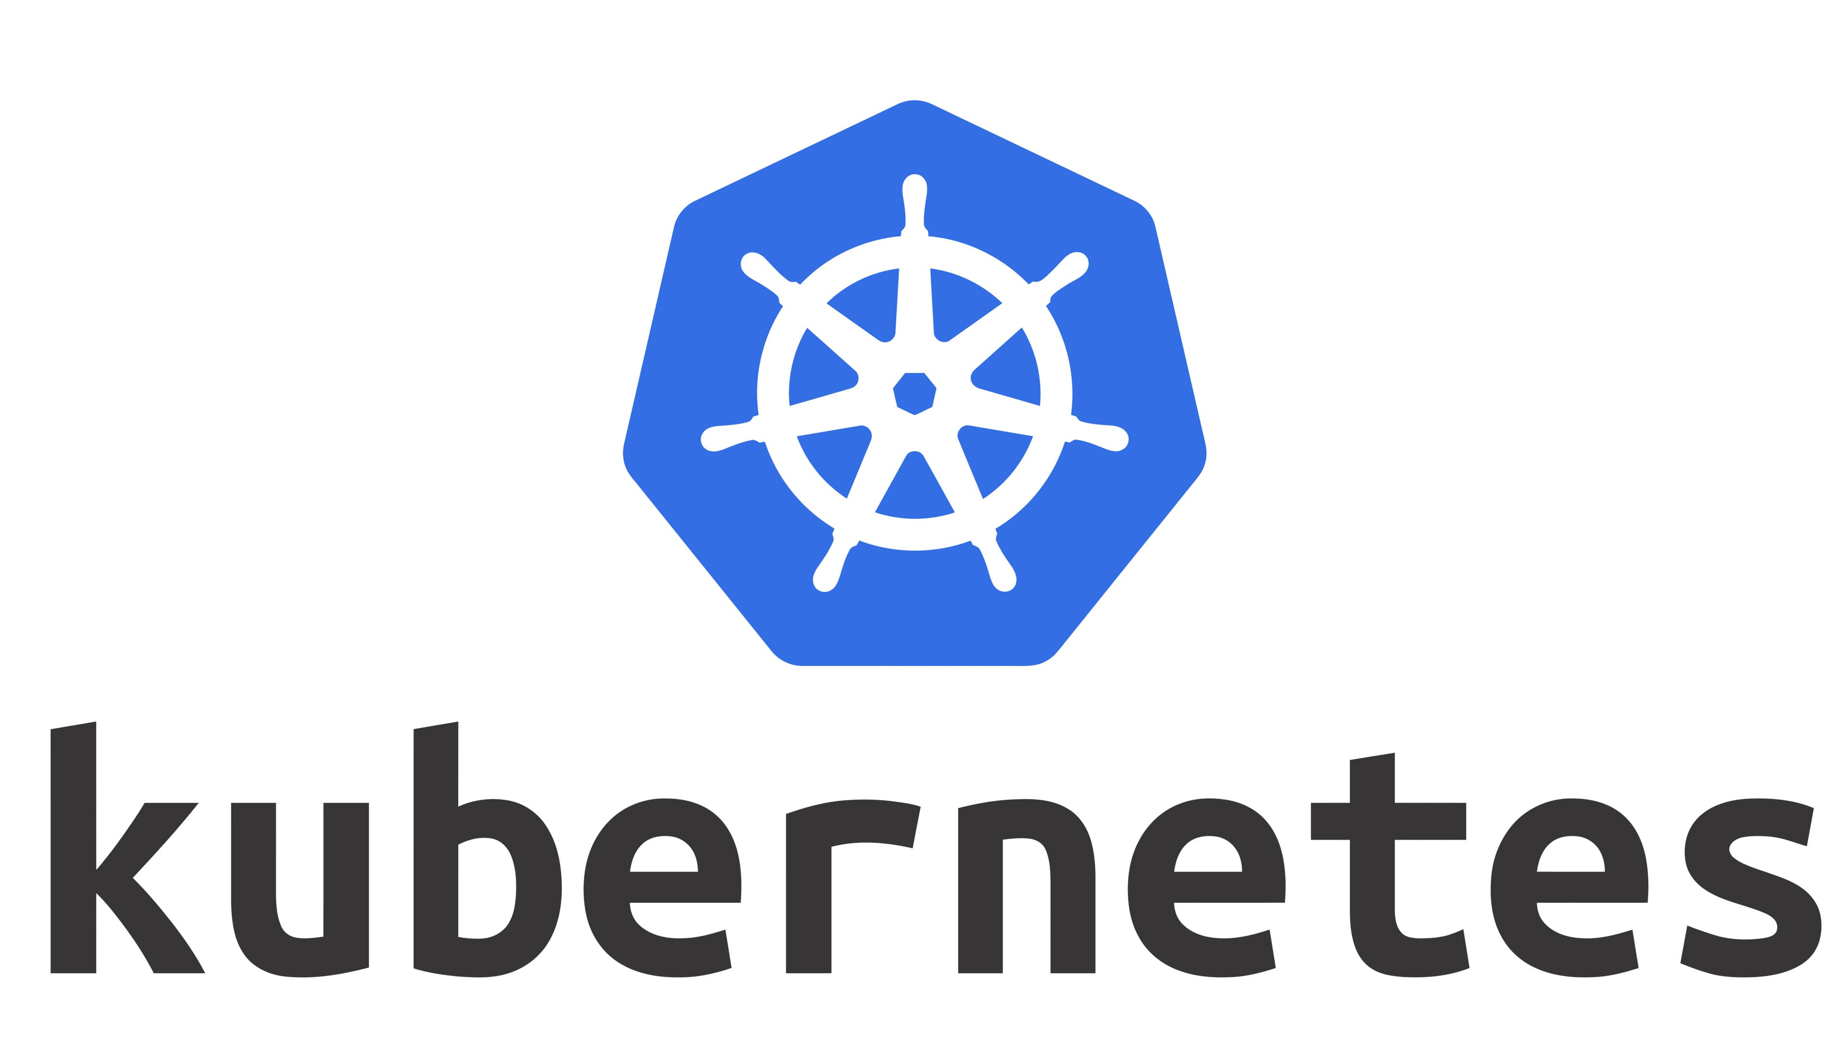
Kubernetes Overview
What is Kubernetes (K8s)?
Kubernetes is a container orchestration platform for scheduling and automating the deployment, management, and scaling of containerized applications.
Originally developed by Google. Now owned by Cloud Native Computing Foundation (CNCF).
Kubernetes stands for “Helmsman” or “Pilot” in Greek (Hence the ship’s wheel as the logo).
Notes:
Kubernetes provides you with a framework to run distributed systems resiliently.

Slide 7
Kubernetes Overview
What can Kubernetes do?
Container Deployment and Running
Automated Rollouts and Rollbacks
Service Discovery and Load Balancing
Storage Orchestration
Autoscaling
Self-healing (for High Availability)
Secret and Configuration Management
Notes:
Deployment: Deploy a specified number of containers to a specified host and keep them running in a desired state.
Automated rollouts and rollbacks – A rollout is a change to a deployment. Kubernetes lets you initiate, pause, resume, or roll back rollouts.
You can describe the desired state for your deployed containers using Kubernetes, and it can change the actual state to the desired state at a controlled rate.
Service discovery and load balancing Kubernetes can expose a container using the DNS name or using their own IP address. If traffic to a container is high, Kubernetes is able to load balance and distribute the network traffic so that the deployment is stable.
Storage orchestration Kubernetes allows you to automatically mount a storage system of your choice, such as local storages, public cloud providers, and more.
Autoscaling: When traffic spikes, Kubernetes autoscaling can spin up new clusters as needed to handle the additional workload.
Self-healing for high availability: When a container fails, Kubernetes can restart or replace it automatically to prevent downtime. It can also take down containers that don’t meet your health-check requirements
Secret and configuration management Kubernetes lets you store and manage sensitive information, such as passwords, OAuth tokens, and SSH keys. You can deploy and update secrets and application configuration without rebuilding your container images, and without exposing secrets in your stack configuration.
Source: https://kubernetes.io/docs/concepts/overview/#why-you-need-kubernetes-and-what-can-it-do

Slide 8
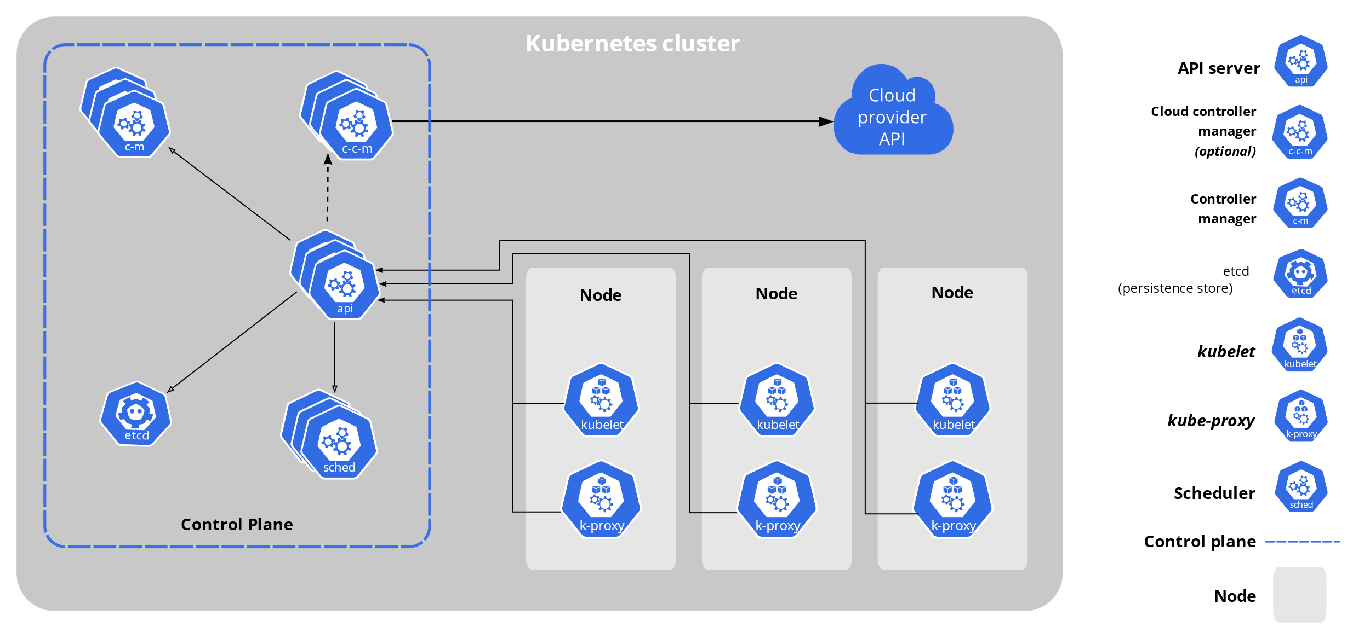
Kubernetes Architecture
Source: https://kubernetes.io/docs/concepts/overview/components/

Slide 9
Kubernetes Overview
K8s components
Cluster: A collection of Nodes.
Nodes/ Worker Nodes: Actual Compute host (Virtual/ Physical Machine). Deploy, run and manage containerized applications via Pods.
Control Plane: Manages the Worker Nodes and Pods in the Cluster.
Pod: A group of containers (one or many) which share the same compute resources (node) and same IP address. A pod is the smallest deployable unit of computing that you can create and manage in Kubernetes.
Notes:
A cluster has at least one node.
A cluster in a Production environment should have at least three nodes for redundancy reasons (to ensure high-availability).
All components of a Control Plane is usually set up in a single node for simplicity reasons.
But those could be spread across multiple hosts for High-availability.
Pods are the Basic unit of scaling.
Pods usually have one container. But in case the containers are tightly coupled, they are included in the same pod.

Slide 10
The Control Plane
The control plane's components make global decisions about the cluster, as well as detecting and responding to cluster events.
Components in the Control Pane:
kube-apiserver
etcd
kube-scheduler
kube-controller-manager
cloud-controller-manager (optional)
Notes:
The API server exposes a REST interface to the Kubernetes cluster. Operations against pods, services etc. are executed by communicating with the endpoints provided by it. It is the interface used to manage, create, and configure Kubernetes clusters. It's how the users, external components, and parts of your cluster all communicate with each other.
The scheduler is responsible for assigning work to the various nodes. It keeps watch over the resource capacity and ensures that a worker node’s performance is within an appropriate threshold.
etcd is a consistent and highly-available key value store used as Kubernetes' backing store for all cluster data.
The controller-manager is responsible for making sure that the shared state of the cluster is operating as expected (i.e. Desired state is achieved). More accurately, the controller manager oversees various controllers which respond to events (e.g., if a node goes down).
The cloud-controller-manager embeds cloud-specific control logic. The cloud-controller-manager only runs controllers that are specific to your cloud provider. If you are running Kubernetes on your own premises, or in a learning environment inside your own PC, the cluster does not have a cloud controller manager.

Slide 11
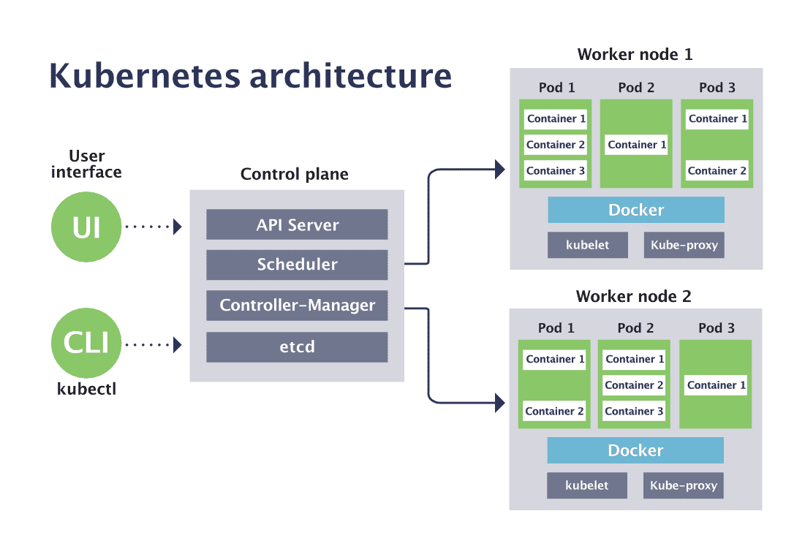
Kubernetes Architecture with Pods
Source: https://www.cncf.io/wp-content/uploads/2020/08/Kubernetes-architecture-diagram-1-1.png

Slide 12
Nodes
Each node runs:
kubelet, a process responsible for communication between the Kubernetes control plane and the Node; it manages the Pods and the containers running on a machine.
kube-proxy maintains network rules on nodes. These network rules allow network communication to your Pods from network sessions inside or outside of your cluster.
A container runtime (like Docker) responsible for pulling the container image from a registry, unpacking the container, and running the application.

Slide 13
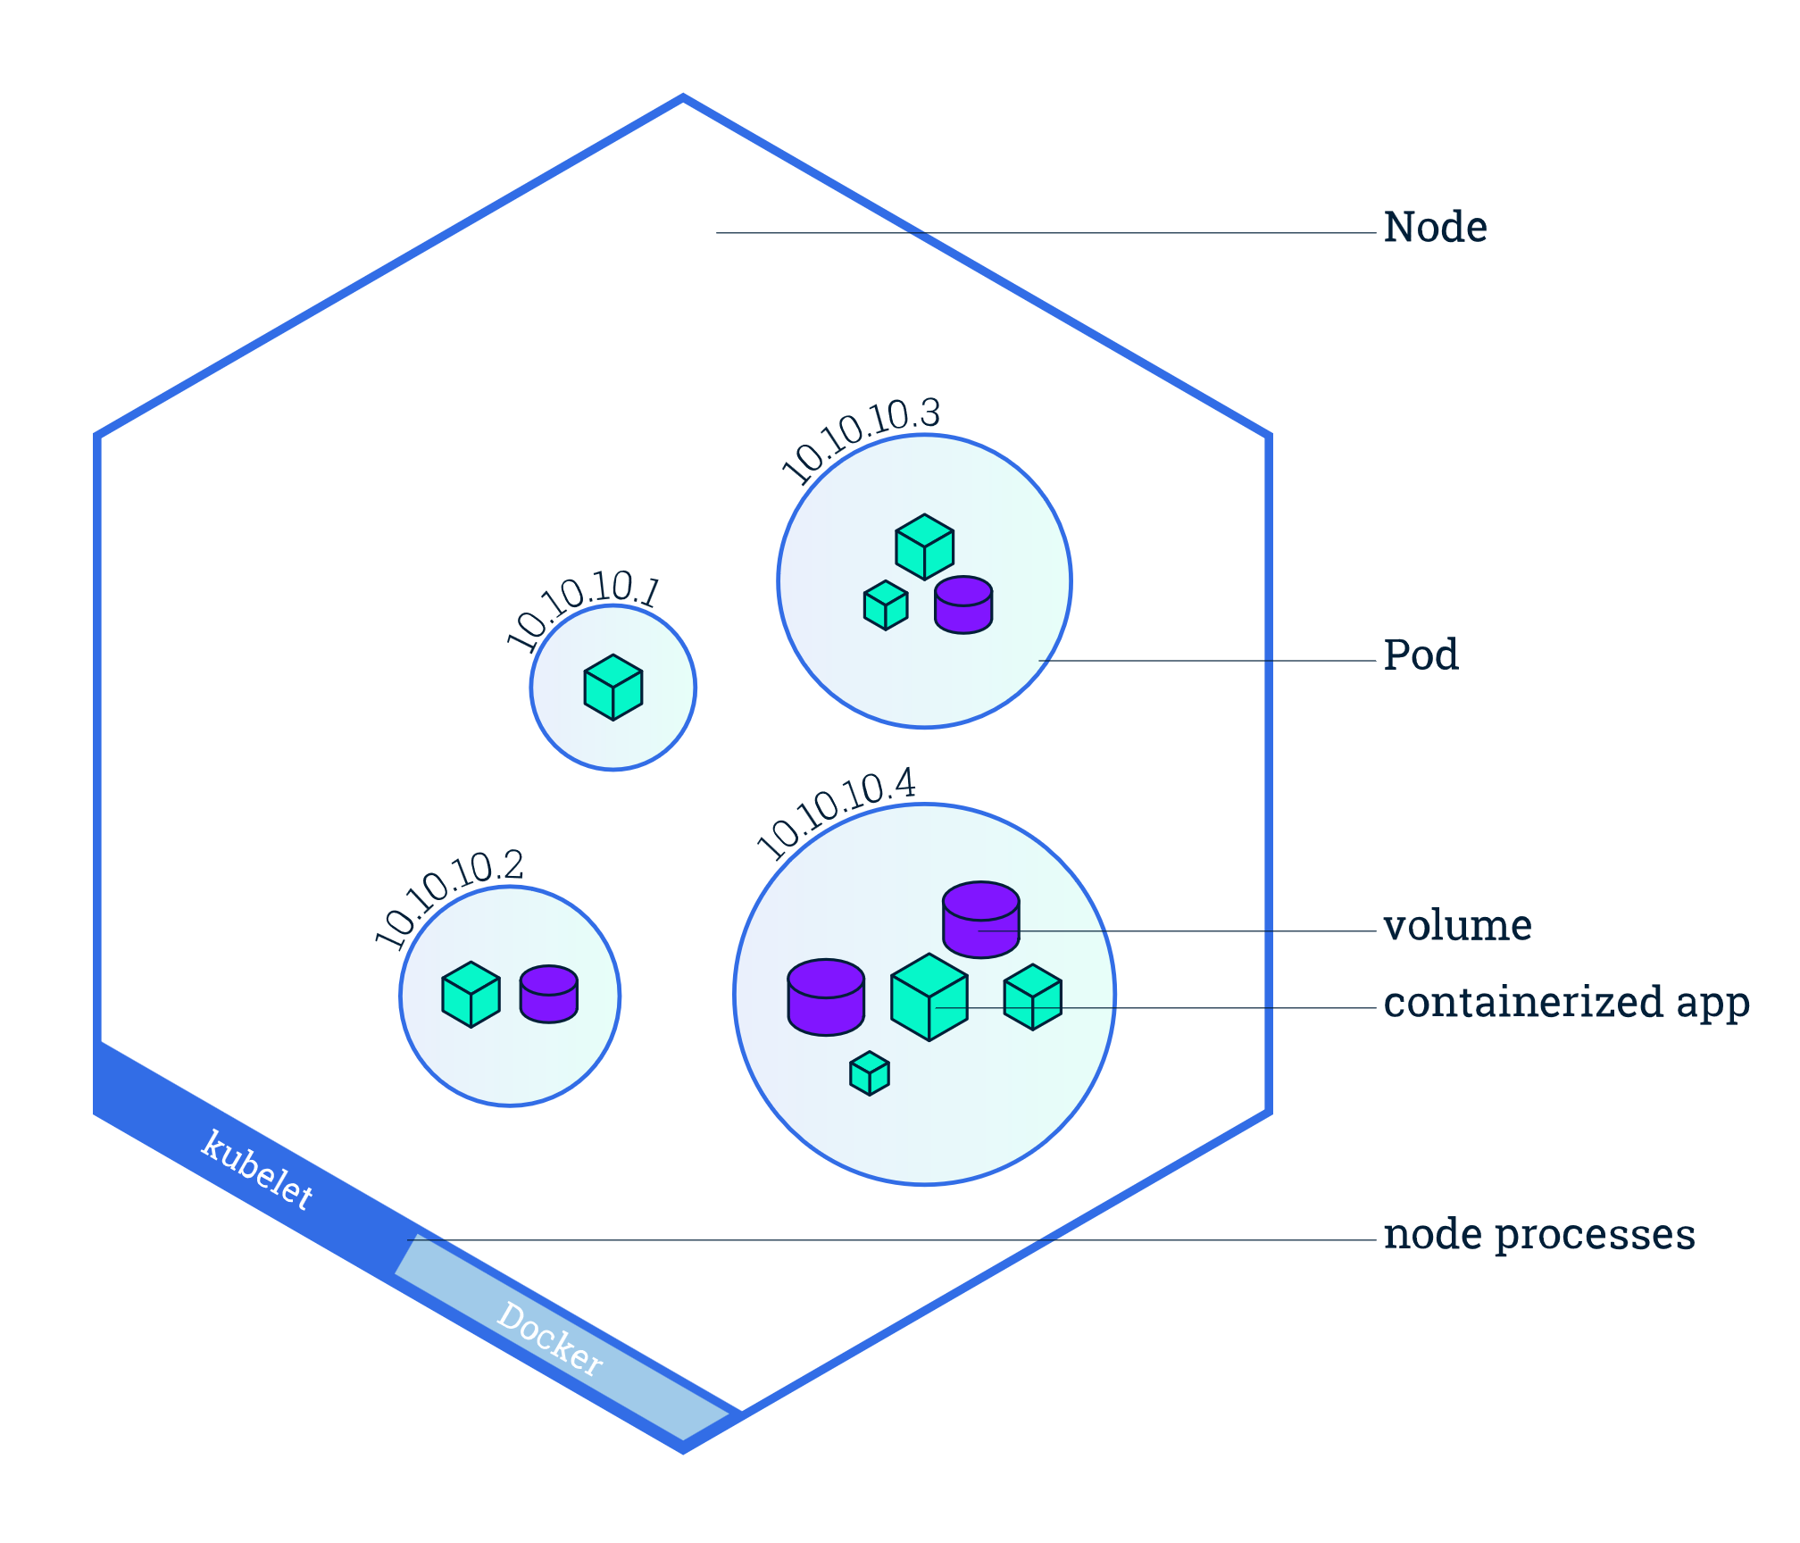
Nodes
A node.
Source: https://kubernetes.io/docs/tutorials/kubernetes-basics/explore/explore-intro/

Slide 14
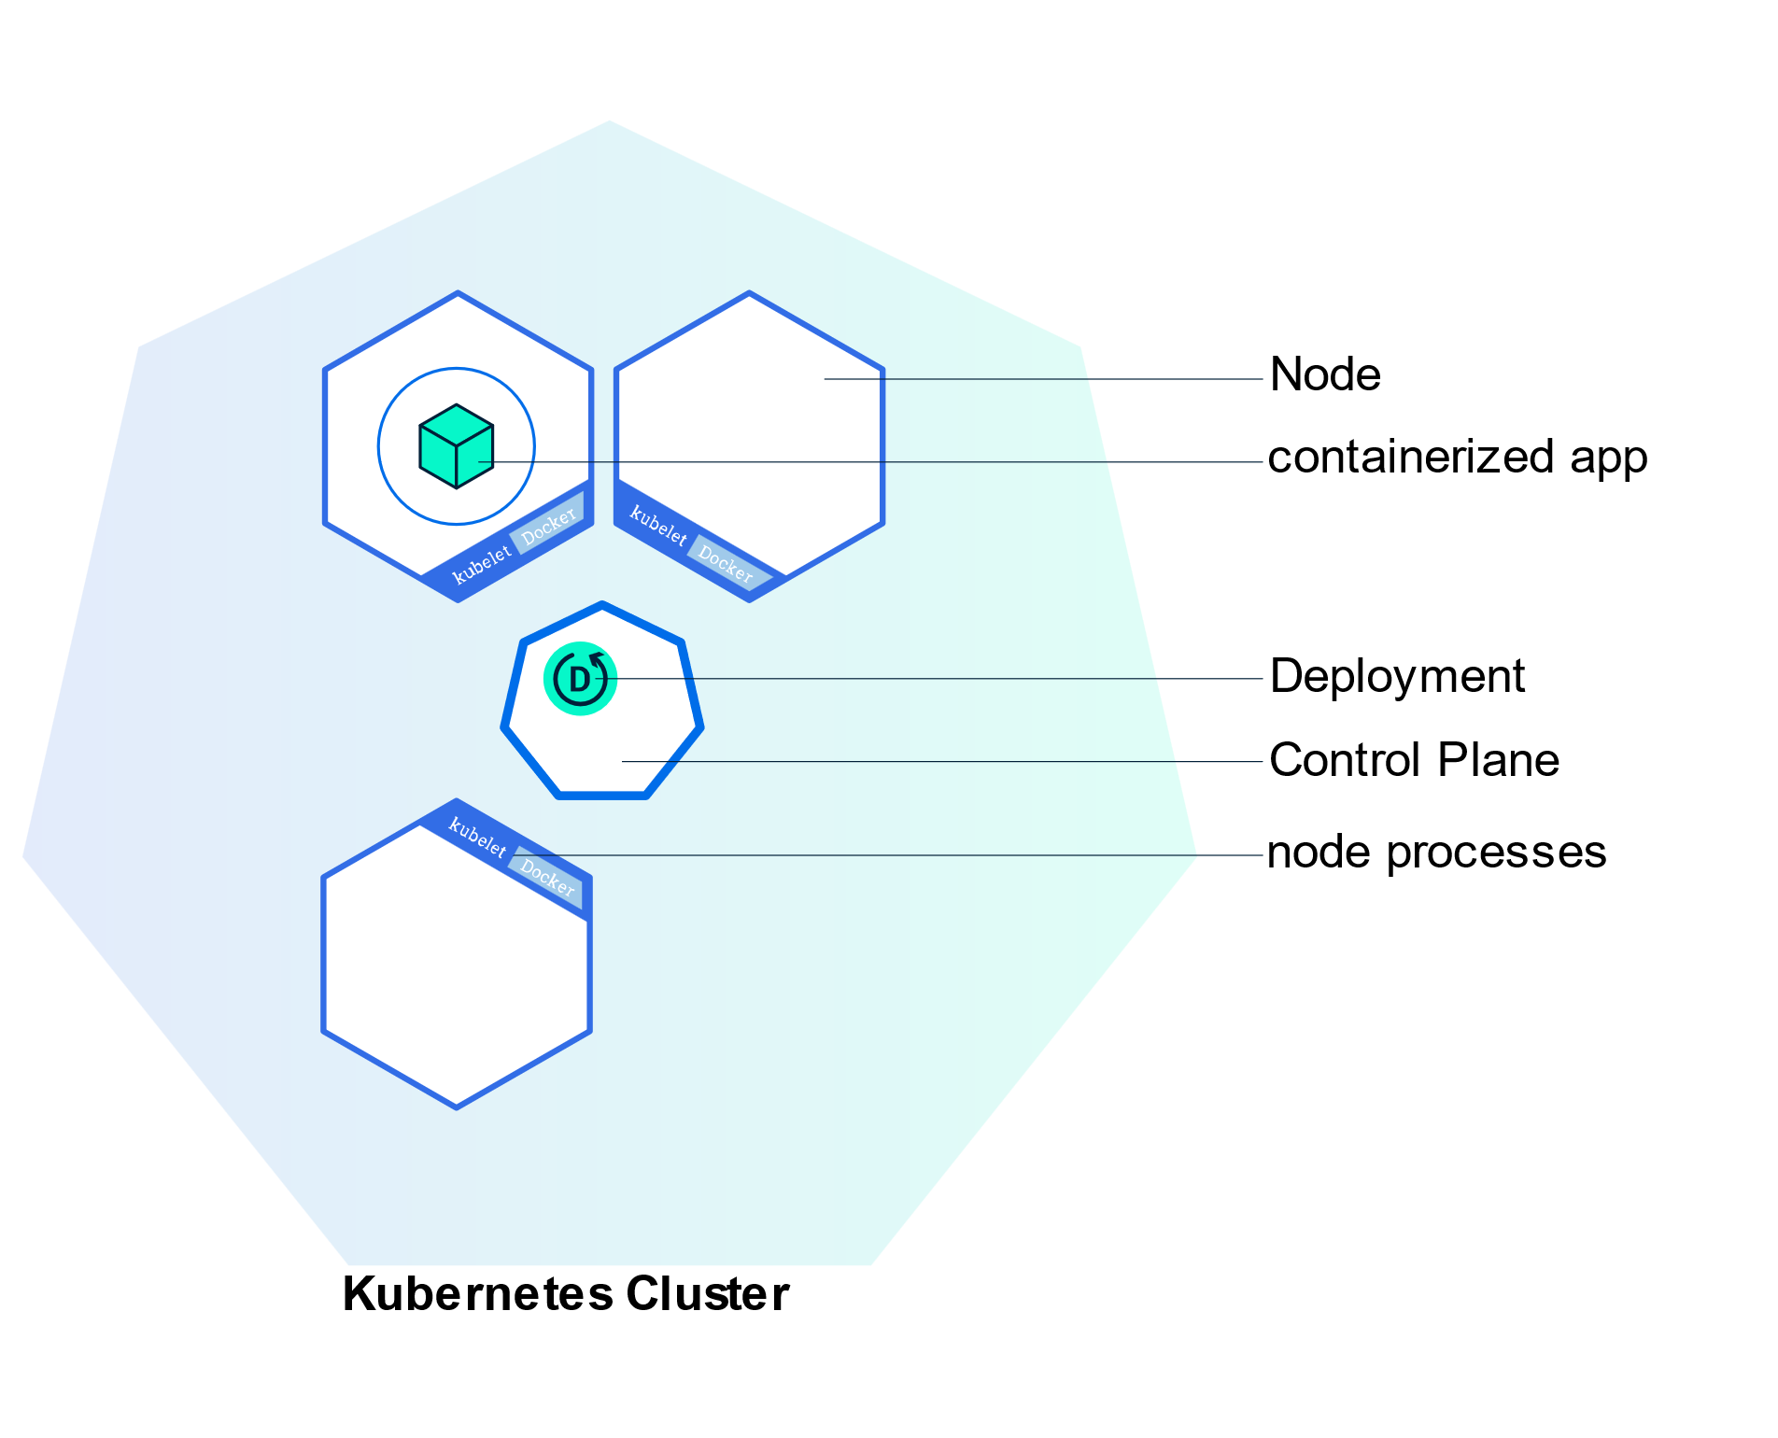
A Cluster
Kubernetes Cluster with a Deployment
14

Slide 15
How does everything wire together?
How do all these wire together?
The desired state of a K8s cluster can be defined in a configuration called Deployment.
The Deployment instructs Kubernetes how to create and update instances of your application.
The Deployment Controller changes the actual state to the desired state.
E.g.: If the Node hosting an instance goes down or is deleted, the Deployment controller replaces the instance with an instance on another Node in the cluster (self-healing).
An application instance is hosted in a Pod.
Traffic to a pod is handled through a Service.
A Service routes traffic across a set of Pods. Services are the abstraction that allows pods to die and replicate in Kubernetes without impacting your application.
Notes:
A Deployment provides declarative updates for Pods and ReplicaSets.
A ReplicaSet maintain a stable set of replica Pods running at any given time. It is used to guarantee the availability of a specified number of identical Pods.

Slide 16
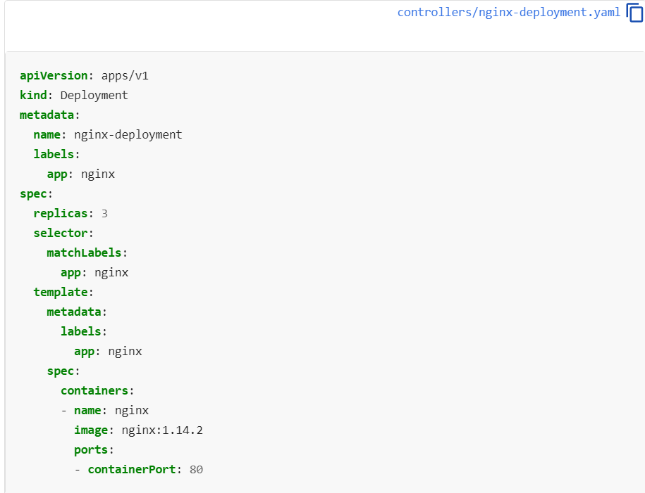
A Deployment
Source: https://kubernetes.io/docs/concepts/workloads/controllers/deployment/

Slide 17
Deployments
Watch this video on how Kubernetes Deployments work.

Slide 18
Some Cloud Offerings
AWS Containers Services
Azure Container Services

Slide 19
Lesson Recap
Microservices Architecture
Containerization
Docker
Container Orchestration
Kubernetes

Slide 20
Lesson Recap
Why did we learn all these?
Microservices is an architectural approach to creating cloud native applications.
Containers are a way of implementing Microservices.
Docker is a platform for packaging, deploying, and running applications in containers.
Kubernetes is a system for managing containerized applications across a cluster of nodes.
Cloud service providers such as AWS and Azure provide managed Docker and Kubernetes services which can be utilized to run applications without having to manage anything on our own.

Slide 21
Self-study
“Learn Kubernetes Basics” – Do this simple hands-on tutorial on your own. No need to install anything.
Then do this Azure Kubernetes Service (AKS) Tutorial to see how managed services simplify using Kubernetes.

Slide 22
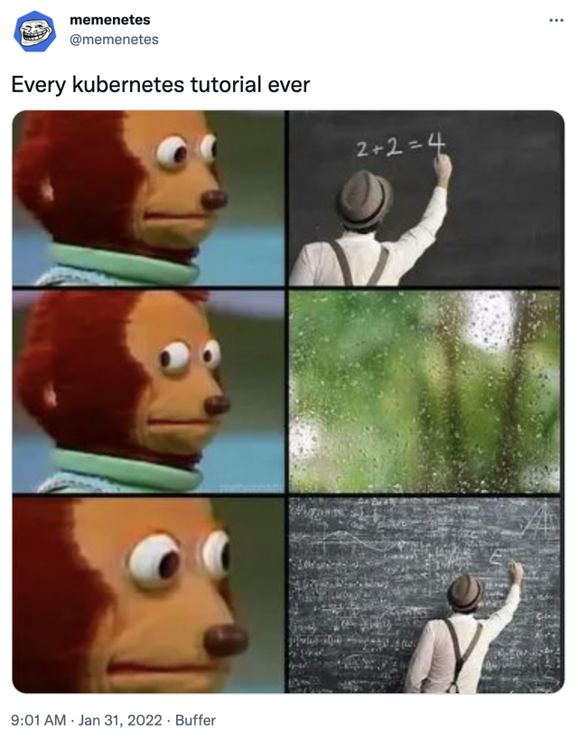
The end
Always refer the official K8s documentation. Many outdated resources are available online.

Slide 23
Acknowledgements and Additional Reading
Kubernetes (K8s) Overview
What is Kubernetes API?

